Slide 1
ROCO218: Control Engineering Dr Ian Howard Lecture 1 Introduction to ROCO218

Slide 2
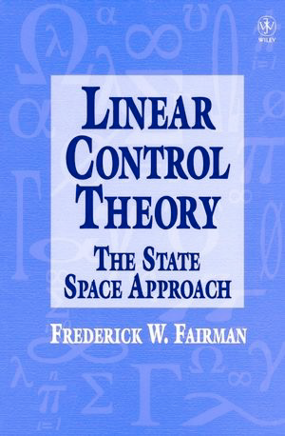

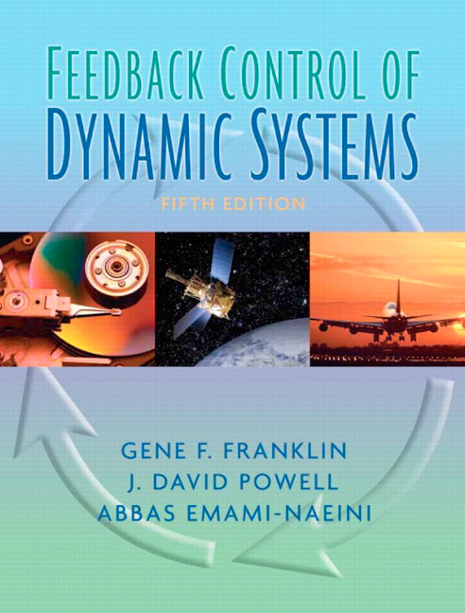

Resources
http://www.cds.caltech.edu/~murray/amwiki/index.php/Main_Page
http://ctms.engin.umich.edu/CTMS

Slide 3
Module overview: Classical control theory
Classical control theory
Differential equations and dynamics model of linear systems
Laplace transforms and transfer functions
System transient performance and steady state performance
System frequency response, and Bode and Nyquist diagrams
PID control

Slide 4
Module overview: Modern control theory
Modern control theory
Revision of key Linear Algebra concepts essential for modern control theory
State space design and representation ands modeling of Linear Time Invariant Systems
Linearization and Stability
Understanding controllability and observability
State feedback control
Observers and optimal control

Slide 5
Assessed learning outcomes
At end of the module the learner will be expected to be able to:
LO1. Develop a transfer function for a given linear system, and characterize the linear system in terms of frequency response and transient performance
LO2. Identify the stability of a given linear system
LO3. Design a feedback controller to achieve stability and to improve dynamics performance for a given linear system

Slide 6


Assessments
There will be a final exam assessments
ROCO218=60%
ROCO223=50%
There will be practical assessments in the form of coursework
ROCO218=40%
ROCO223=50%

Slide 7

Laboratory practicals
Practical sessions
Using MATLAB to simulate control systems
Using SIMULINK graphic programming for simulation
Coursework will be realistic simulation of inverted pendulum

Slide 8
Coursework assessment
Please only submit your report as a PDF.
Submission via DLE
When you write your report, you must include you student number on every page of the report in a header and also include it in the document filename!
Each laboratory report should contain a few pages of written explanation (although it can be more than this) as well as a set of images and diagrams to explain your solutions to the practical exercises.
Please also incorporate links to uploaded YouTube videos to illustrate operation of your project.
Please use the correct report format!

Slide 9
ROCO218: Control Engineering Dr Ian Howard Lecture 1 Introduction to control engineering

Slide 10

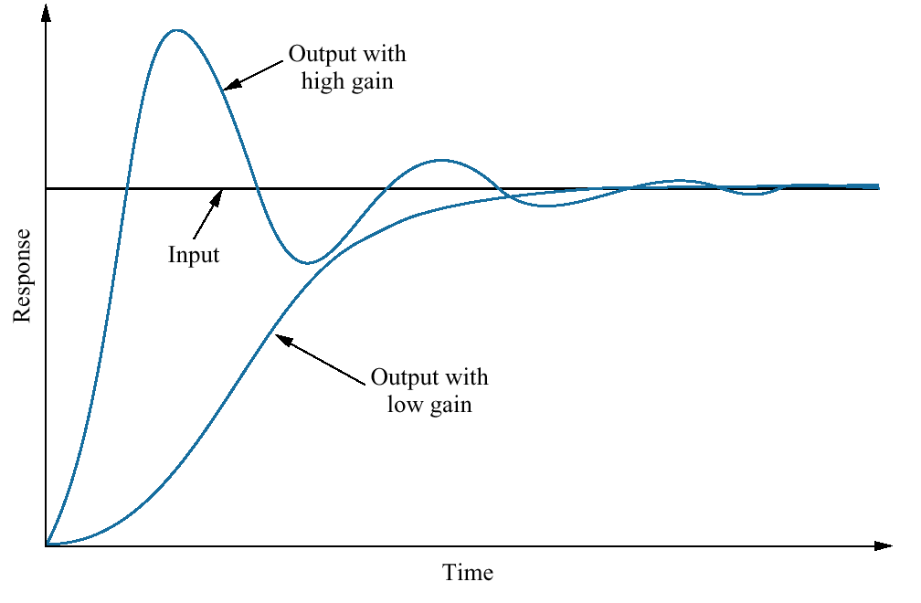
Engineering goals of control theory
We want to control complex dynamic systems
Generate appropriate actions so systems do what we would like them to do
Parameters of the controller affect performance
Response of a position control system showing effect of high and low controller gain on the output response
Think about steering a ship
Not easy as it doesn’t immediately respond

Slide 11
History of control
Ad hoc control schemes (BC - 18 century):
Classical control (18th century - 1950s ): - Contents of 1st part of this course
Modern control (1960s) - Contents of 2nd part of this course
Post-modern control (1980s)
Transfer function
Frequency domain
Ingenious mechanical control systems
State-space model
Time domain
Post-modern control (present day / Research):
Optimal control
Hybrid control, etc.
Robust control
Control of high-dimensional complex
systems, e.g.: time varying networks, etc.

Slide 12
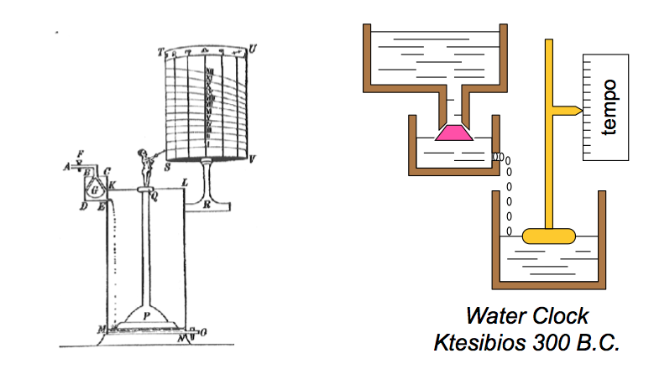
History of control: Water clock
First tank controlled to generate constant water pressure
Second tank shows increase in volume over time – indicating passage of time
Toilets still use the first tank filing mechanism to shut of water entering when it is full

Slide 13
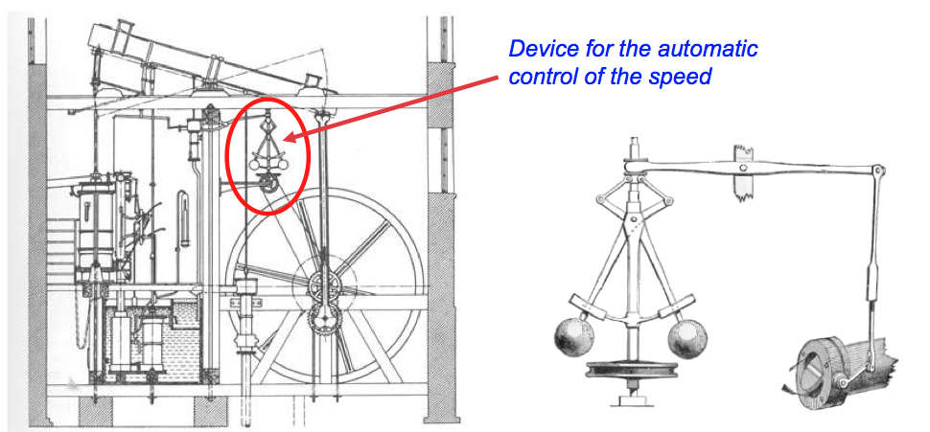
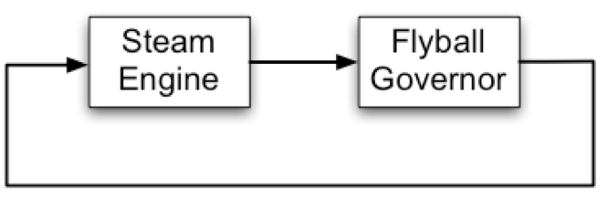
History of control: James Watt’s steam governor
James Watt’s automatic control of the speed of a steam engine (1798)
As engine speed increases, fly balls are thrown outwards and linkage to valve cut off reduces steam supply, thereby regulating speed
Feedback schematic

Slide 14
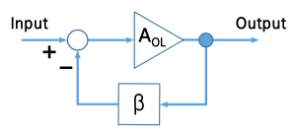
History of control: Negative feedback amplifier
Electronic amplifier with negative feedback Harold Black, 1927)
Scheme has important features
An amplifier with gain A_{OL}
A feedback network β which senses the output signal and can transform it in some way (e.g., with gain of or filtering it)
A summing circuit
Amplifier circuit subtracts a fraction of its output from its input, so that the negative feedback opposes the original signal.
The negative feedback
improves stability, linearity, frequency response, step response
reduces sensitivity to parameter variations (e.g. due to manufacturing or environment)

Slide 15

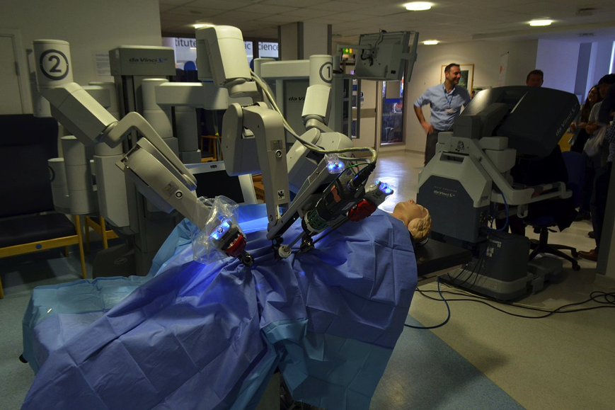
Control theory is ubiquitous
Aerospace and space applications
Blue Origin
https://www.youtube.com/watch?v=9pillaOxGCo
Medical applications
Da Vinci surgery robot
https://www.youtube.com/watch?v=e_fUVBdwmwA

Slide 16
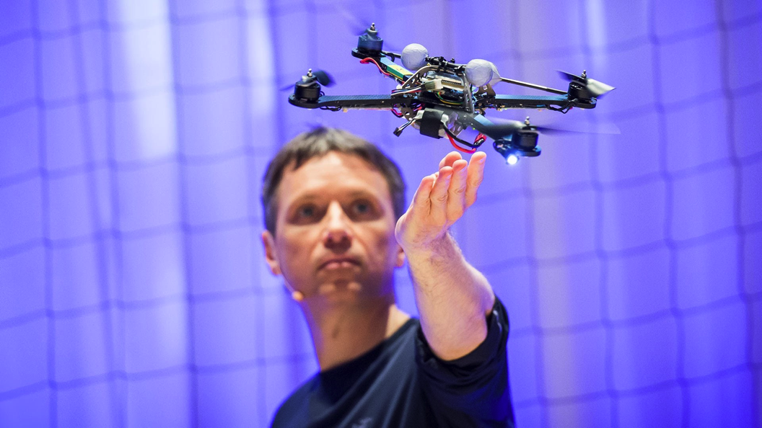
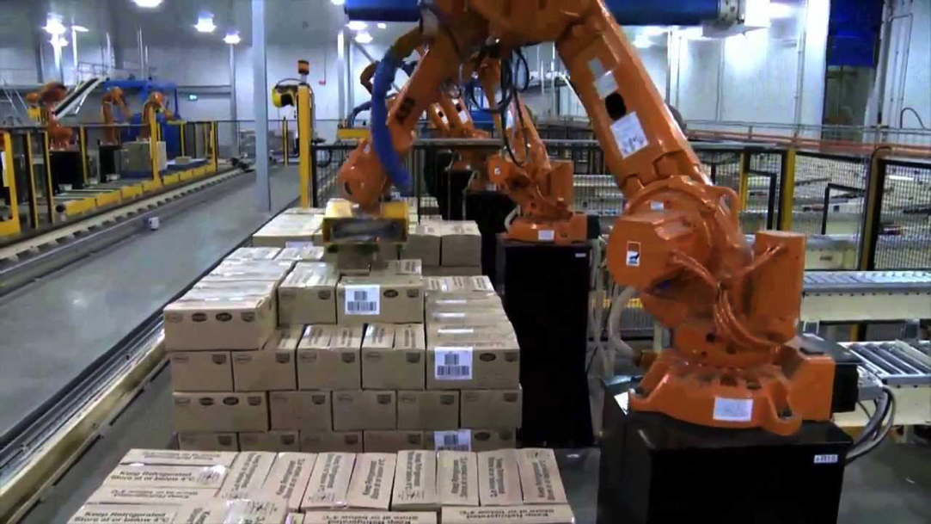
Control theory is ubiquitous
Robotics
Quadcopters
https://youtu.be/w2itwFJCgFQ
https://youtu.be/3CR5y8qZf0Y
Manufacturing industry
https://youtu.be/7U1-X5ogsKA

Slide 17
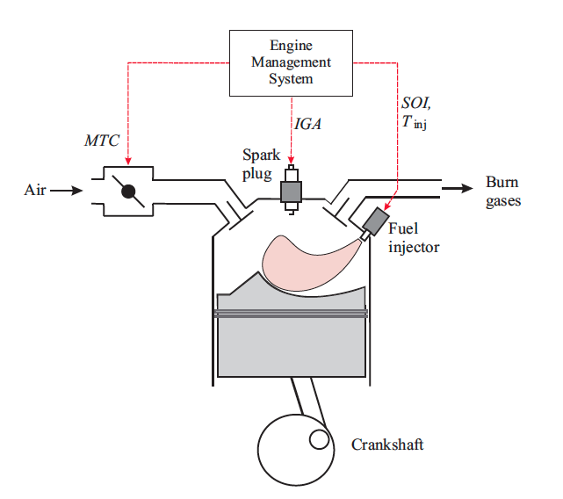

Control theory is ubiquitous
Automotive industry
- Engine control
Industrial process control
-Mixing materials
-Flow control

Slide 18
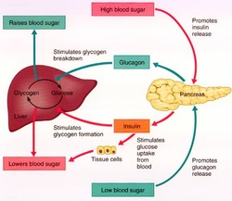

Control theory is ubiquitous
Biological systems
-Regulation of hormones
-Blood rate
-Breathing
-etc.
Power networks
-Switching in supplies

Slide 19
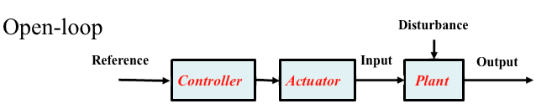
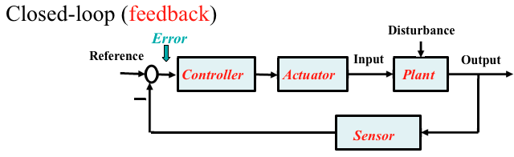
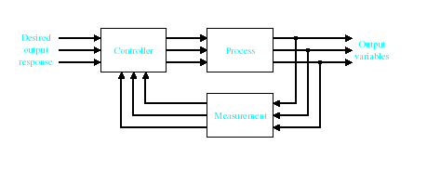
Types of control systems
Open-Loop Control Systems utilize a feed forward controller or control actuator to obtain the desired response.
Closed-Loop Control Systems utilizes feedback to compare the actual output to the desired output response.
Multivariable Control System
Multiple inputs and outputs

Slide 20
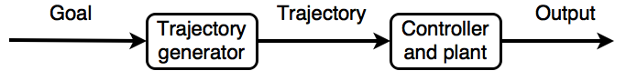
Trajectory generation
To produce a movement trajectory, a separate module is usually used to generate the goal in a feed forward manner.
In this scheme, although the controller can use feedback from the plant and its measured output, no feedback is used in the generation of the goal trajectory.

Slide 21
Feedforward control
Basic pre-processing idea where the goal signal corresponds with a given output.
We generally need to find a way to convert the goal into an effective signal to control input to the plant.
An inverse model maps the input goal to the signal needed to control the plant.
One simple feed forward way to achieve this is to provide the input signal with an inverse model of the plant
However, such feed forward control assumes that it is known exactly how the plant will behave and these schemes cannot account for unexpected disturbances present in the task.

Slide 22
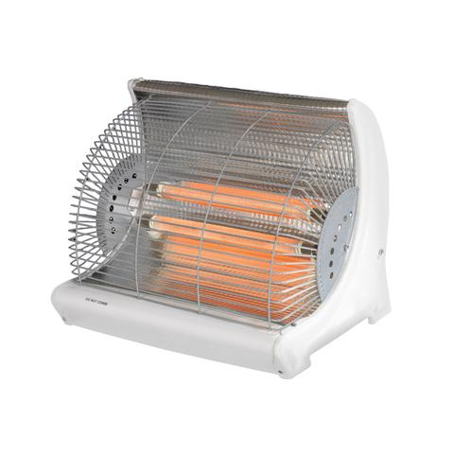
Open loop control
System
input
Control signal
System
output
CONTROLLER
PLANT
Open-loop control systems: those systems in which the output has no effect on the control action
E.g. electric heater where just the right number of elements switched on and then take no notice of how warm room becomes

Slide 23
Comments on open-loop control systems
Open loop systems are
Simple construction and ease of maintenance.
Less expensive than a closed-loop system.
No stability problem.
Recalibration is necessary from time to time.
Sensitive to disturbances, so less accurate.
Good
Bad
When should we apply open-loop control?
The relationship between the input and output is exactly known
There are neither internal nor external disturbances.
Measuring the output precisely is very hard or economically infeasible

Slide 24
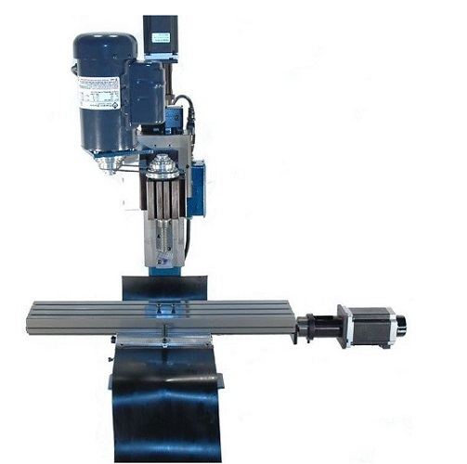
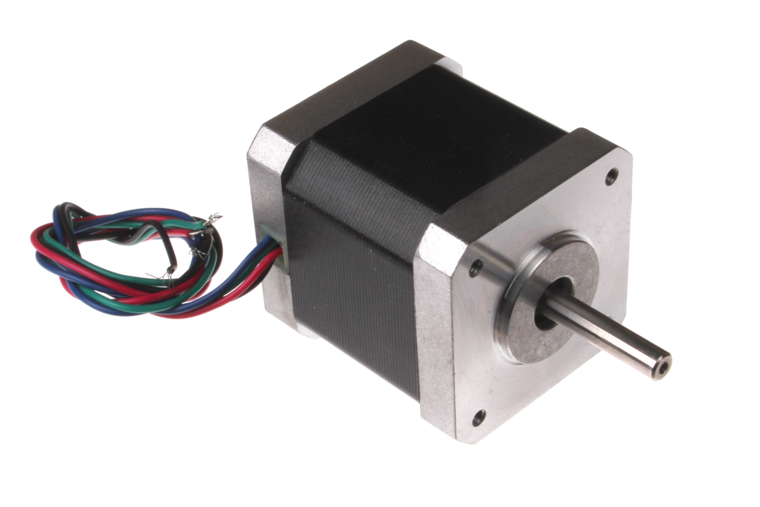
Stepper motor normally used open-loop
Provided calibrated and no steps are lost this solution is very effective e.g. for CNC, 3D printers

Slide 25
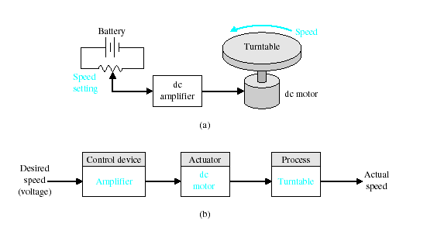
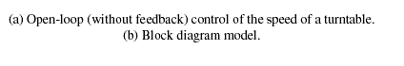
Open loop example

Slide 26
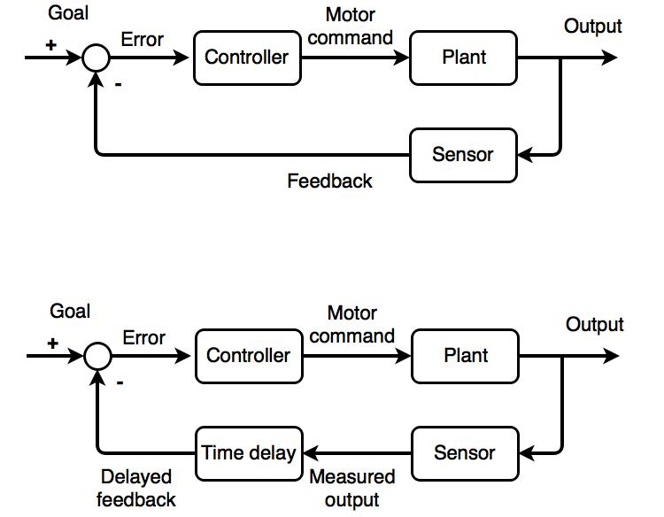
Output feedback control
Feedback control is often used in engineering systems to stabilize operating goals when noise is present.
Under output feedback control, the sensory consequences are used to modify the control input by comparing it with the goal to calculate error and this is then used in an attempt to get the plant to meet the required goals.
Error is fed via the controller to generate motor commands.
System output then moves to the goal.
This scheme will also have the ability to compensate for disturbances.

Slide 27
Closed loop control
Expected
value
Control signal
System
output
Error
CONTROLLER
PLANT
Closed-loop control systems use feedback
They compare the actual output with the expected value and take actions based on this error
Reduce the effect of disturbance
Make a system insensitive to variations
Can stabilize an unstable system

Slide 28
Block diagram of output feedback control system
n
Disturbance
r
e
u
y
Controller
Actuator
Plant
Expected value
Controlled
variable
-
Error
Sensor
lead-out point:
Here, the signal is transferred along two separate routes.
comparison component (comparison point) :
its output equals the algebraic sum of all input signals.
“+”: plus; “-”: minus
The Block represents
the function and name of its
corresponding mode, we don’t
need to draw detailed structure,
and the line guides for the transfer route.
Notes:
Here we present the block diagram. Because of block diagrams' simplicity and versatility, they are often used by control engineering to model all types of systems.
A block diagram can be used simply to describe the composition and interconnection of a system. A block diagram can simply show how the system components are interconnects and give no mathematical details. If the mathematical and functional relations of all the system elements are known, it can also be used as a tool for the analytic or computer solution of the system.

Slide 29
Block diagram of output feedback control system
n
Disturbance
r
e
u
y
Controller
Actuator
Plant
Expected value
Controlled
variable
-
Error
Sensor
1.Plant: a physical object to be controlled such as a mechanical device, a heating furnace, a chemical reactor or a spacecraft.
Plant
Notes:
Here we present the block diagram. Because of block diagrams' simplicity and versatility, they are often used by control engineering to model all types of systems.
A block diagram can be used simply to describe the composition and interconnection of a system. A block diagram can simply show how the system components are interconnects and give no mathematical details. If the mathematical and functional relations of all the system elements are known, it can also be used as a tool for the analytic or computer solution of the system.

Slide 30
Block diagram of output feedback control system
n
Disturbance
r
e
u
y
Controller
Actuator
Plant
Expected value
Controlled
variable
-
Error
Sensor
2.Controlled variable: the variable controlled by Automatic Control System , generally refers to the system output.
Controlled
variable
Notes:
Here we present the block diagram. Because of block diagrams' simplicity and versatility, they are often used by control engineering to model all types of systems.
A block diagram can be used simply to describe the composition and interconnection of a system. A block diagram can simply show how the system components are interconnects and give no mathematical details. If the mathematical and functional relations of all the system elements are known, it can also be used as a tool for the analytic or computer solution of the system.

Slide 31
Block diagram of output feedback control system
n
Disturbance
r
e
u
y
Controller
Actuator
Plant
Expected value
Controlled
variable
-
Error
Sensor
3.Expected value : the desired value of controlled variable based on requirement, often it is used as the reference input
Expected
value
Notes:
Here we present the block diagram. Because of block diagrams' simplicity and versatility, they are often used by control engineering to model all types of systems.
A block diagram can be used simply to describe the composition and interconnection of a system. A block diagram can simply show how the system components are interconnects and give no mathematical details. If the mathematical and functional relations of all the system elements are known, it can also be used as a tool for the analytic or computer solution of the system.

Slide 32
Block diagram of output feedback control system
n
Disturbance
r
e
u
y
Controller
Actuator
Plant
Expected value
Controlled
variable
-
Error
Sensor
4.Controller: an agent that can calculate the required control signal.
Controller
Notes:
Here we present the block diagram. Because of block diagrams' simplicity and versatility, they are often used by control engineering to model all types of systems.
A block diagram can be used simply to describe the composition and interconnection of a system. A block diagram can simply show how the system components are interconnects and give no mathematical details. If the mathematical and functional relations of all the system elements are known, it can also be used as a tool for the analytic or computer solution of the system.

Slide 33
Block diagram of output feedback control system
n
Disturbance
r
e
u
y
Controller
Actuator
Plant
Expected value
Controlled
variable
-
Error
Sensor
5.Actuator: a mechanical device that takes energy, usually created by air, electricity, or liquid, and converts that into some kind of motion.
Actuator
Notes:
Here we present the block diagram. Because of block diagrams' simplicity and versatility, they are often used by control engineering to model all types of systems.
A block diagram can be used simply to describe the composition and interconnection of a system. A block diagram can simply show how the system components are interconnects and give no mathematical details. If the mathematical and functional relations of all the system elements are known, it can also be used as a tool for the analytic or computer solution of the system.

Slide 34
Block diagram of output feedback control system
n
Disturbance
r
e
u
y
Controller
Actuator
Plant
Expected value
Controlled
variable
-
Error
Sensor
6.Sensor : a device that measures a physical quantity and converts it into a signal which can be read by an observer or by an instrument.
Sensor
Notes:
Here we present the block diagram. Because of block diagrams' simplicity and versatility, they are often used by control engineering to model all types of systems.
A block diagram can be used simply to describe the composition and interconnection of a system. A block diagram can simply show how the system components are interconnects and give no mathematical details. If the mathematical and functional relations of all the system elements are known, it can also be used as a tool for the analytic or computer solution of the system.

Slide 35
Block diagram of output feedback control system
n
Disturbance
r
e
u
y
Controller
Actuator
Plant
Expected value
Controlled
variable
-
Error
Sensor
7.Disturbance: the unexpected factors disturbing the normal functional relationship between the controlling and controlled parameter variations.
Disturbance
Notes:
Here we present the block diagram. Because of block diagrams' simplicity and versatility, they are often used by control engineering to model all types of systems.
A block diagram can be used simply to describe the composition and interconnection of a system. A block diagram can simply show how the system components are interconnects and give no mathematical details. If the mathematical and functional relations of all the system elements are known, it can also be used as a tool for the analytic or computer solution of the system.

Slide 36
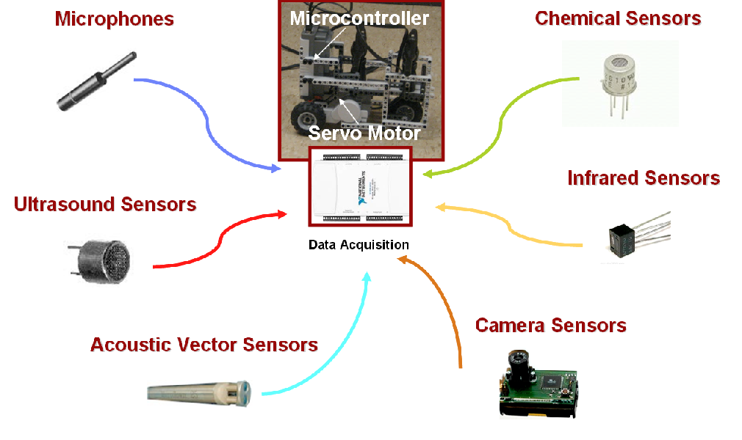
Control systems need sensors
Sensors needed to make measurements
Can be used for feedback signal
But sensors can also be noisy
In general sensors need to be modeled too!

Slide 37
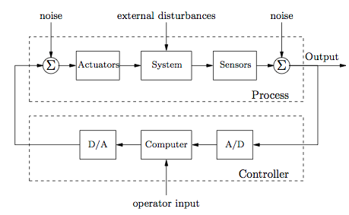
Digital computer control system
Analog-to-digital (A/D) reads input signals
Controller is implemented by a digital computer
Digital-to-Analog (D/A) generates control signal
NB: analogue and hybrid computers can also be used!
What about the human brain?

Slide 38
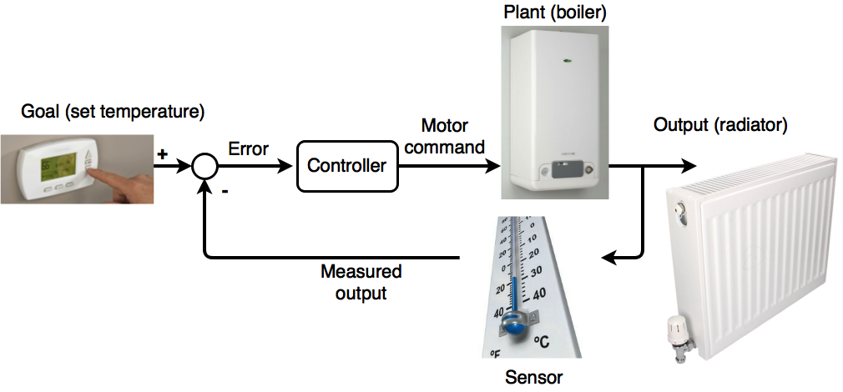
Example of simple feedback control

Slide 39
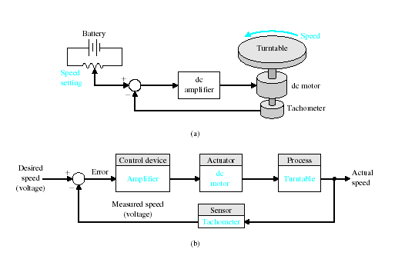
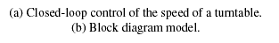
Closed-loop example

Slide 40
But time delays are a problem
Time delays in processing place limitations on feedback control schemes
When signal fed back in-phase system can go unstable!

Slide 41
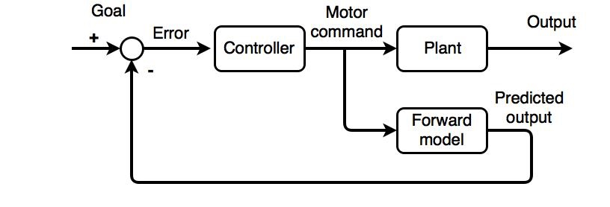
Output feedback control with forward model
Time delays during processing place limitations on feedback control schemes.
One solution to this problem is to employ a control scheme that employs a forward model of the plant dynamics to provide an un-delayed estimate of the system output.
The forward model estimates the output, which is then used in the feedback loop, rather than having to wait until actual direct feedback is received.
Using a forward model to predict sensory output, which is then used in the feedback path stabiles plant operation

Slide 42
Closed-loop control systems
Feedback is a key idea in the discipline of control.
In practice, feedback control system and closed-loop control system are used interchangeably
Closed-loop control always implies the use of feedback control action in order to reduce system error
What is the Control System Engineer trying to achieve?
First, understand the broader picture of the application to best apply a suitable control system.
A good control system is a system that will
generate a response quickly and without oscillation (good transient response),
have low error once settled (good steady-state response),
and will not oscillate wildly or damage that system (stability).

Slide 43
Key points regarding feedback control
Main advantages of feedback:
reduce disturbance effects
make system insensitive to variations
stabilize an unstable system
create well-defined relationship between output and reference
Potential drawbacks of feedback:
cause instability if not used properly
couple noise from sensors into the dynamics of a system
increase the overall complexity of a system

Slide 44
Open-loop versus closed-loop
Open-loop control
Closed-loop control
Simple structure,
low cost
Ability to correct error
Easy to regulate
High accuracy and
resistance of disturbance
Complex structure,
high cost
Low accuracy and resistance to disturbance
Selecting parameter is critical (may cause stability problem)
Notes:
.

Slide 45
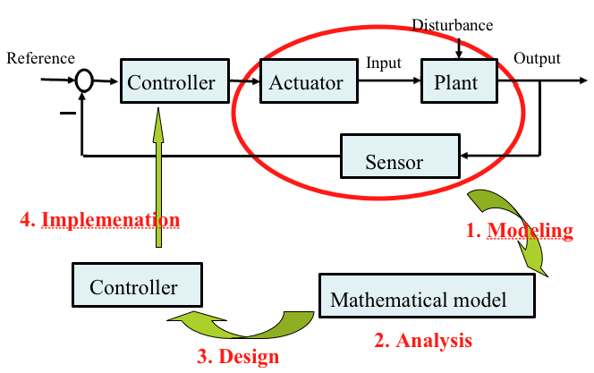
Controller design process
Design control logic to ensure the dynamics of the closed loop system are stable
- i.e. bounded disturbances give bounded errors
Want to achieve desired behavior
- good disturbance rejection, fast responsiveness to changes in goal, etc.

Slide 46
Controller design process
Controller design achieved by modeling and analysis techniques that capture the essential physics of the system
This permit the consideration of possible behaviors in the presence of uncertainty, noise and component failure

Slide 47
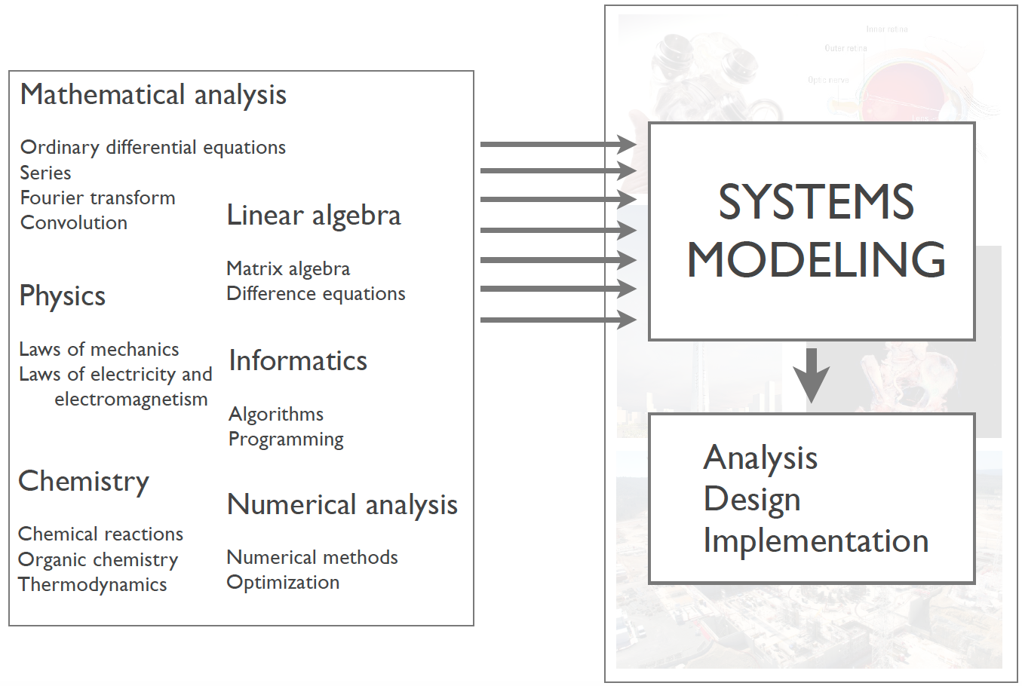
Controller design process

Slide 48
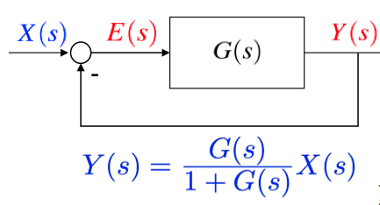
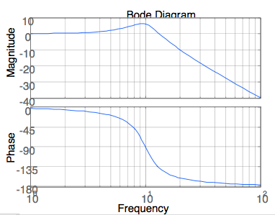
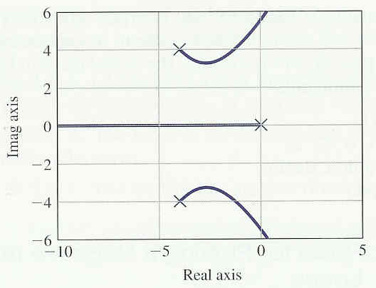
Classical control theory
Modeling systems using transfer function and a block diagrams
Frequency techniques based on Laplace transform, Bode Diagrams etc.
Cam be applied to mechanical, electrical, electromechanical systems, etc.
Analysis using:
Time and Frequency response
Stability: Routh-Hurwitz criterion, Nyquist criterion, etc
Design using:
Root locus technique, frequency response techniques
PID control, lead/lag compensator, etc

Slide 49
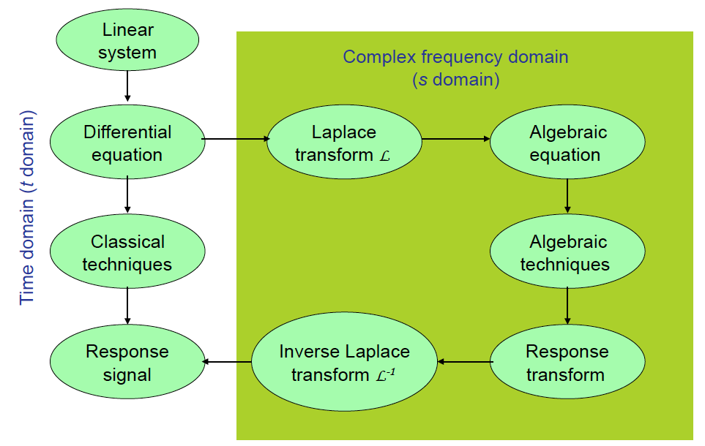
Overview of classical control theory

Slide 50
Limitations of classical control theory
Classical control theory deals only with:
Single-input single-output (SISO) systems
Linear time-invariant (LTI) systems
But
No optimality concept in controller design
No robustness consideration, except gain margin and phase margin
It can’t handle nonlinear and time varying systems!
Therefore
We need an advanced control theory

Slide 51
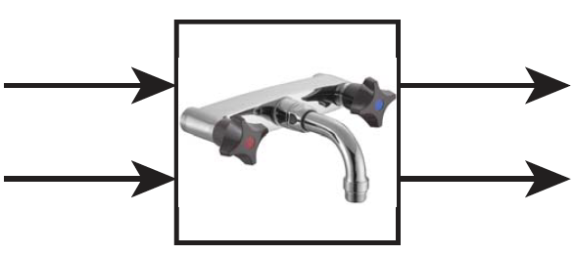
System with undesirable cross coupling
Consider system with an undesirable cross coupling:
Two handle mixer taps
Output signals
Input signals
Hot water tap setting
Temperature
Cold water tap setting
Water flow
Both input signals affects a given output signal
- Both output signals affected by/depend on a given input signal
Hot tap changes temperature and flow rate
- Cold tap changes both temperature and flow rate

Slide 52
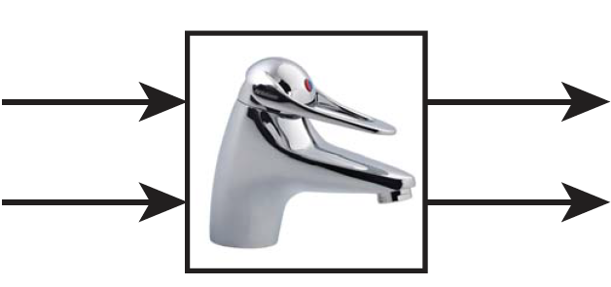
System with independent coupling
Much easier to control uncoupled systems
Consider one-handle mixer system with a “nice” cross coupling
Input signals
Output signals
Angle temperature setting
Water flow
Angle flow setting
Temperature
Each input signal now affects (almost) only one output signal
Each output is now affected (almost) only by one input signal

Slide 53
Interlude 10 minute break

Slide 54
ROCO218: Control Engineering Dr Ian Howard Lecture 1 Simple introduction to Matlab

Slide 55
What is Matlab?
MATLAB (MATrix LABoratory)
High-performance language for technical computing, computation, visualization, and programming in an easy-to-use environment
Typical uses include:
Math and computation
Algorithm development
Modeling, simulation, and prototyping
Data analysis, exploration, and visualization
Scientific and engineering graphics
Application development, including Graphical User Interface building

Slide 56
Matrix details
Rows and columns are always numbered starting at 1
Matlab matrices are of various types to hold different kinds of data (usually floats or integers)
A single number is a 1 x 1 matrix in Matlab!
Matlab variables are not given a type, and do not need to be declared
Any matrix can be assigned to any variable

Slide 57
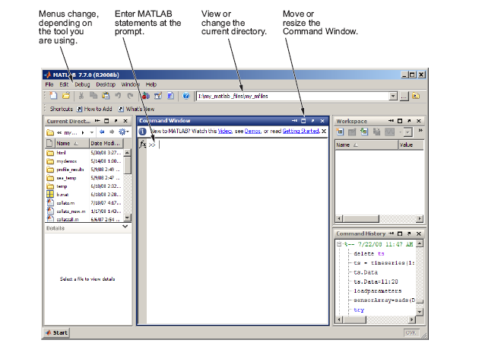
Main Matlab Window

Slide 58
Building matrices with [ ]
A = [1 3 5]
1
3
5
Rows x columns = 1x3
A = [1; 3; 5;]
1
3
Rows x columns = 3x1
5
A = [2 7 4; 3 8 9]
2
7
4
Rows x columns = 2x3
3
8
9
B = [ A A ]
2
7
4
2
7
4
Rows x columns = 2x6
3
8
9
3
8
9

Slide 59
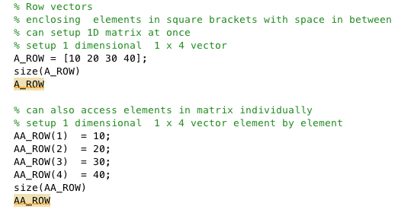
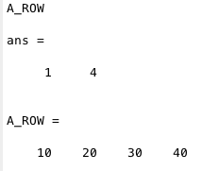
Matrices in Matlab

Slide 60
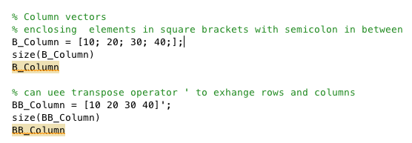
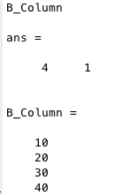
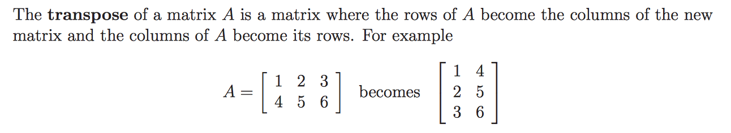
Matrices in Matlab

Slide 61
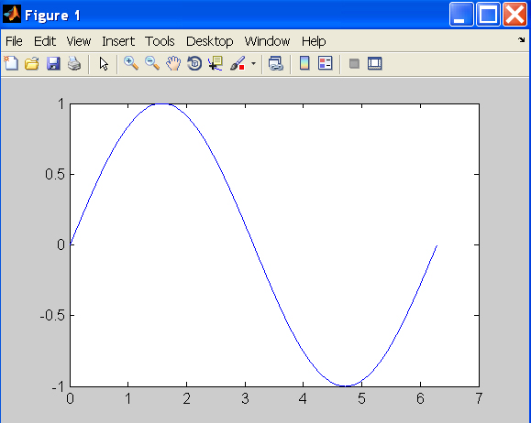
Plot data
t = 0:pi/100:2*pi;
y = sin(t);
plot(t,y);

Slide 62
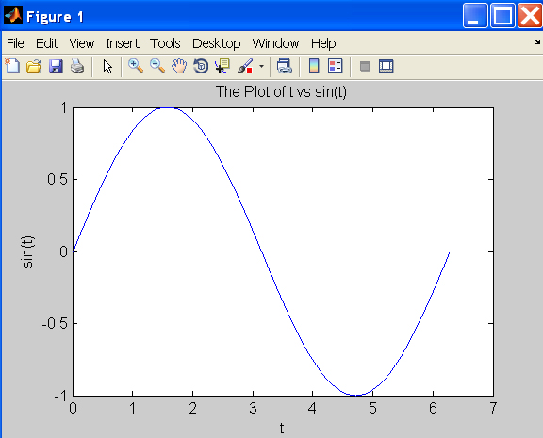
Add title and labels
xlabel(‘t’);
ylabel(‘sin(t)’);
title(‘The plot of t vs sin(t)’);

Slide 63
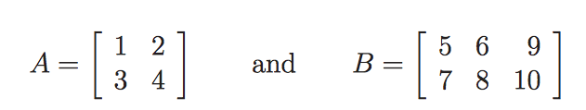
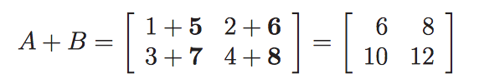
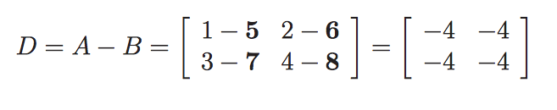
Adding matrices
Add the elements
Matlab: A + B
Subtract the elements
Matlab: A - B

Slide 64
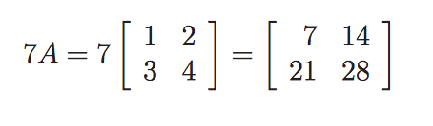
Multiplication of a matrix by a skalar
Matlab: 7 * [1 2; 3 4;]

Slide 65
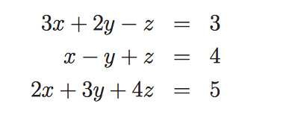
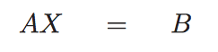


Use matrices to represent equations
Can write equations as
Where
We will use this a lot when we look at state space representations!

Slide 66

Multiplying row and column matrices
Multiply rows by columns
Matlab: A * B

Slide 67


Multiplying 2x2 matrices

Slide 68

Multiplying 3x3 matrices

Slide 69


Multiplying non-square matrices
Matlab: A * B

Slide 70
Matlab matrix multiplication
Matrix multiplication
A = [1 2 ; 4 5]
B = A * A calculates
Matrix element wise multiplication
B = A .* A calculates

Slide 71
Inverse of a 2x2 matrix
For a 2x2 matrix
Its determinant:
Matlab: det(A)
Inverse:
Matlab: inv(A)

Slide 72





For loop and if statement
Output:
Output:
Output:

Slide 73

Script m-file
When you have a group of commands that are expected to be executed repeatedly it is convenient to save them in a file.
Here we save previous example as forif.m.
A script shares the same scope with that which it operates.

Slide 74



Function m-files
Can build function in Matlab
Recommendation you save function in file with filename same as function name
It can then be called from a script, another function, or on command line:
Define function
Call function from script
Output figure

Slide 75
Some Frequently Used Functions
magic(n) % creates a special n x n matrix; handy for testing
zeros(n,m) % creates n x m matrix of zeros (0)
ones(n,m) % creates n x m matrix of ones (1)
rand(n,m) % creates n x m matrix of random numbers
repmat(a,n,m) % replicates a by n rows and m columns
diag(M) % extracts the diagonals of a matrix M
help elmat % list all elementary matrix operations ( or elfun)
abs(x); % absolute value of x
exp(x); % e to the x-th power
fix(x); % rounds x to integer towards 0
log10(x); % common logarithm of x to the base 10
rem(x,y); % remainder of x/y
mod(x, y); % modulus after division – unsigned rem
sqrt(x); % square root of x
sin(x); % sine of x; x in radians
acoth(x) % inversion hyperbolic cotangent of x

Slide 76
Some Frequently Used Functions
Generally, MATLAB’s default graphical settings are adequate which make plotting fairly effortless. For more customized effects, use the get and set commands to change the behavior of specific rendering properties.
h= plot(1:5) % returns the handle of this line plot
get(h) % to view line plot’s properties and their values
set(h, ‘lineWidth’) % show possible values for lineWidth
set(h, ‘lineWidth’, 2) % change line width of plot to 2
gcf % returns current figure handle
gca % returns current axes handle
get(gcf) % gets current figure’s property settings
set(gcf, ‘Name’, ‘My First Plot’) % Figure 1 => Figure 1: My First Plot
get(gca) % gets the current axes’ property settings
figure(1) % create/switch to Figure 1 or pop Figure 1 to the front
clf % clears current figure
close % close current figure; “close 3” closes Figure 3
close all % close all figures

Slide 77
Further information
No point of me reinventing the wheel
Loads of documentation available on using Matlab
Have a look yourselves
Matlab get started guide
-http://www.mathworks.co.uk/help/pdf_doc/matlab/getstart.pdf
Book
-J.M. Maciejowski, Getting started with MATLAB.

